Slide 1
M4Museum Museum Motion & Mood Mapping
eNTERFACE 2015
Aug 10th – Sep 4th

Slide 2
Final Summary
The Team
The Project
Objectives
Schedule (first week)
Insitu Experimentation
Expected results & Sequels

Slide 3
M4Museum Museum Motion & Mood Mapping
The TEAM

Slide 4
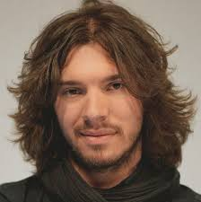
The Team
Leading team
Charles-Alexandre DELESTAGE (aka 18)
PHD Student at the DeVisu Laboratory (Valenciennes)
Specialized in audiovisual and multimedia automation and user (spectator) experience during visualization
25 y-o, 26 y-o, single but very attractive ^^
Contact : +336 65 43 36 49
Email : ca.delestage@gmx.fr

Slide 5
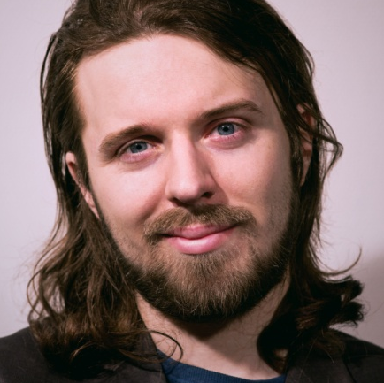
The Team
Leading team
Willy YVART (aka Willypédia)
PHD student at both TCTS (Mons) and DeVisu (Valenciennes) . Loves bishops
Specialized in music, audiovisual techniques and moodal/emotional experience, everything except the dishes… :/
27 y-o, no more single, sorry ladies ;)
Contact : +336 77 31 78 74
Email : willy.yvart@neuf.fr

Slide 6
The Team
Leading team
Willy YVART (aka Willypédia)
PHD student at both TCTS (Mons) and DeVisu (Valenciennes)
Specialized in music, audiovisual techniques and moodal/emotional experience, everything except the dishes… :/
27 y-o, no more single, sorry ladies ;)
-> Charles is still available ^^
Contact : +336 77 31 78 74
Email : willy.yvart@neuf.fr

Slide 7
The Team
Project Team

Slide 8
The Team
Project Team
Experimentation Team

Slide 9
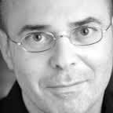
The Team
Project Team
Experimentation Team
Daniel Schmitt

Slide 10
The Team
Project Team
Experimentation Team
Daniel Schmitt
Jérôme Hennebert

Slide 11
The Team
Project Team
Experimentation Team
Daniel Schmitt
Jérôme Hennebert
Muriel Meyer

Slide 12
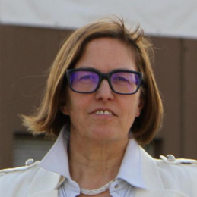
The Team
Project Team
Experimentation Team
Daniel Schmitt
Jérôme Hennebert
Muriel Meyer
The Boss
Sylvie Leleu-Merviel

Slide 13
M4Museum Museum Motion & Mood Mapping
The Project

Slide 14
The Project
M4Museum aims at determining the user’s moodal/emotional experience while visiting a museal exhibition

Slide 15
The Project
M4Museum aims at determining the user’s moodal/emotional experience while visiting a museal exhibition

Slide 16
The Project
M4Museum aims at determining the user’s moodal/emotional experience while visiting a museal exhibition
How to ?

Slide 17
The Project
M4Museum aims at determining the user’s moodal/emotional experience while visiting a museal exhibition
How to ?
Mood spotting based on a valence/arousal interface

Slide 18
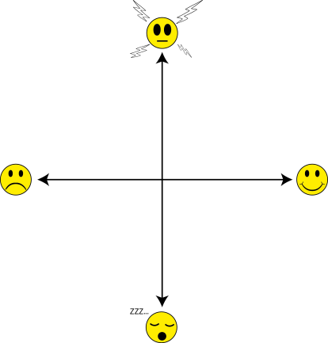
The Project
M4Museum aims at determining the user’s moodal/emotional experience while visiting a museal exhibition
How to ?
Mood spotting based on a valence/arousal interface

Slide 19
The Project
M4Museum aims at determining the user’s moodal/emotional experience while visiting a museal exhibition

Slide 20
The Project
M4Museum aims at determining the user’s moodal/emotional experience while visiting a museal exhibition
How to ?

Slide 21
The Project
M4Museum aims at determining the user’s moodal/emotional experience while visiting a museal exhibition
How to ?
Indoor geolocalization and eye-tracking monitoring throughout the visit

Slide 22

The Project
M4Museum aims at determining the user’s moodal/emotional experience while visiting a museal exhibition
How to ?
Indoor geolocalization and eye-tracking monitoring throughout the visit

Slide 23
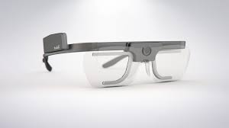
The Project
M4Museum aims at determining the user’s moodal/emotional experience while visiting a museal exhibition
How to ?
Indoor geolocalization and eye-tracking monitoring throughout the visit

Slide 24
The Project
M4Museum aims at determining the user’s moodal/emotional experience while visiting a museal exhibition

Slide 25
The Project
M4Museum aims at determining the user’s moodal/emotional experience while visiting a museal exhibition

Slide 26
The Project
M4Museum aims at determining the user’s moodal/emotional experience while visiting a museal exhibition
How to ?

Slide 27
The Project
M4Museum aims at determining the user’s moodal/emotional experience while visiting a museal exhibition
How to ?
Subjective remediation debriefing/interview

Slide 28
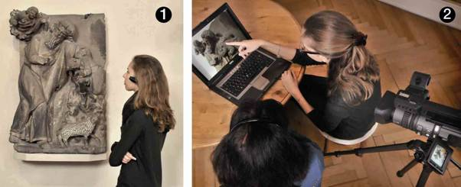
The Project
M4Museum aims at determining the user’s moodal/emotional experience while visiting a museal exhibition
How to ?
Subjective remediation debriefing/interview

Slide 29
M4Museum Museum Motion & Mood Mapping
Objectives

Slide 30
Objectives

Slide 31
Objectives
Exhibition room

Slide 32
Objectives
Exhibition room

Slide 33
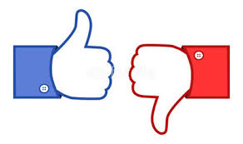
Objectives
Exhibition room

Slide 34
Objectives
Exhibition room

Slide 35
M4Museum Museum Motion & Mood Mapping
Schedule

Slide 36
Schedule

Slide 37
Schedule
First and second week :

Slide 38
Schedule
First and second week :
Android application prototyping

Slide 39
Schedule
First and second week :
Android application prototyping
Moodal/semantic dictionary composition

Slide 40
Schedule
First and second week :
Android application prototyping
Moodal/semantic dictionary composition
+ integration test

Slide 41
Schedule
First and second week :
Android application prototyping
Moodal/semantic dictionary composition
+ integration test
Database stuff

Slide 42
Schedule
First and second week :
Android application prototyping
Moodal/semantic dictionary composition
+ integration test
Database stuff
Semantic stuff

Slide 43
Schedule
First and second week :
Android application prototyping
Moodal/semantic dictionary composition
+ integration test
Database stuff
Semantic stuff
Geolocalization tests

Slide 44
Schedule
First and second week

Slide 45
Schedule
First and second week
Third and fourth week

Slide 46
Schedule
First and second week
Third and fourth week :
(Charles’s birthday)

Slide 47
Schedule
First and second week
Third and fourth week :
In situ experimentation at the “Palais des Beaux-Arts” of Lille (France)

Slide 48
Schedule
First and second week
Third and fourth week :
In situ experimentation at the “Palais des Beaux-Arts” of Lille (France)
Data gathering and treatment

Slide 49
Schedule
First and second week
Third and fourth week :
In situ experimentation at the “Palais des Beaux-Arts” of Lille (France)
Data gathering and treatment (still in progress)

Slide 50
M4Museum Museum Motion & Mood Mapping
Insitu Experimentation

Slide 51
Insitu Experimentation
The “Palais des Beaux-Arts”, Lille France

Slide 52
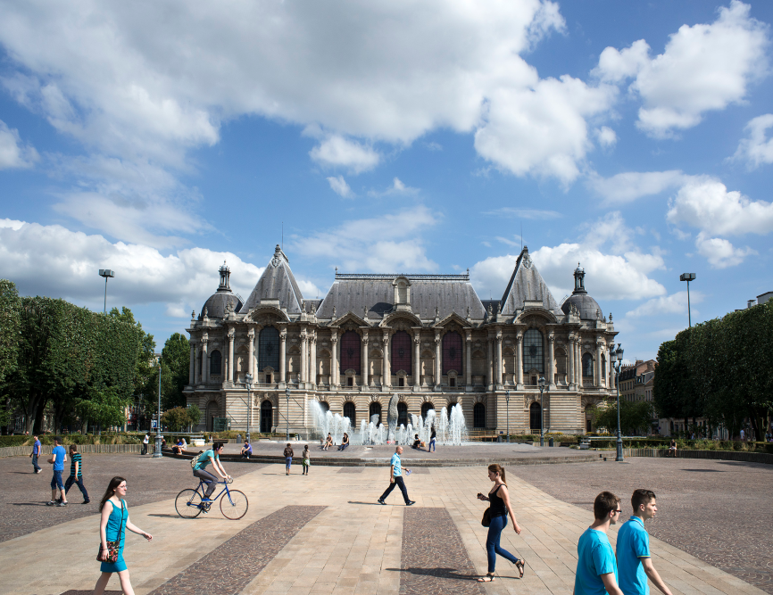
Insitu Experimentation
The “Palais des Beaux-Arts”, Lille France

Slide 53
Insitu Experimentation
The “Palais des Beaux-Arts”, Lille France
Why ?

Slide 54
Insitu Experimentation
The “Palais des Beaux-Arts”, Lille France
Why ?
Strong relationship between DeVisu and the PBA

Slide 55
Insitu Experimentation
The “Palais des Beaux-Arts”, Lille France
Why ?
Strong relationship between DeVisu and the PBA
Metropole Européenne de Lille: +1.1 millions people

Slide 56
Insitu Experimentation
The “Palais des Beaux-Arts”, Lille France
Why ?
Strong relationship between DeVisu and the PBA
Metropole Européenne de Lille: +1.1 millions people
Renowned collection

Slide 57
Insitu Experimentation
The “Palais des Beaux-Arts”, Lille France
Why ?
Strong relationship between DeVisu and the PBA
Metropole Européenne de Lille: +1.1 millions people
Renowned collection

Slide 58
Insitu Experimentation
The “Palais des Beaux-Arts”, Lille France
Experimentation location

Slide 59
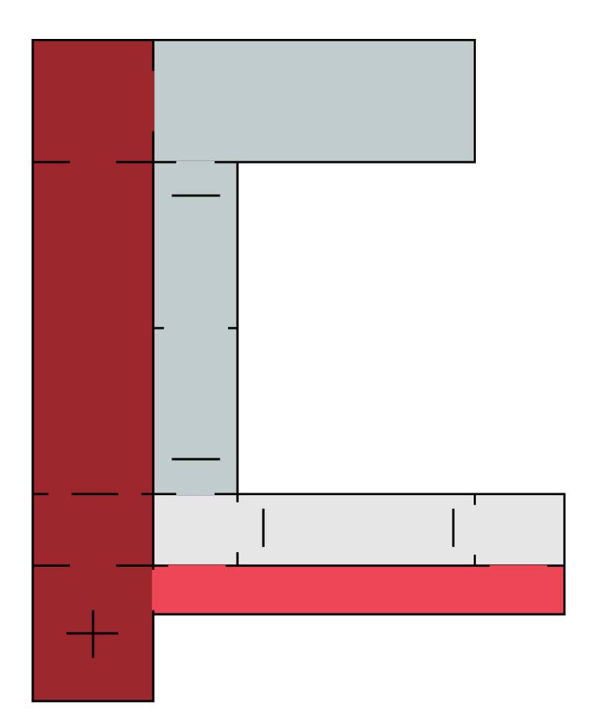
Insitu Experimentation
The “Palais des Beaux-Arts”, Lille France
Experimentation location

Slide 60

Insitu Experimentation
The “Palais des Beaux-Arts”, Lille France
Experimentation location

Slide 61
Insitu Experimentation
The “Palais des Beaux-Arts”, Lille France
Experimentation location

Slide 62
Insitu Experimentation
The “Palais des Beaux-Arts”, Lille France
Experimentation location
Protocol

Slide 63
Insitu Experimentation
The “Palais des Beaux-Arts”, Lille France
Experimentation location
Protocol
Participant selected in the public in the entrance

Slide 64
Insitu Experimentation
The “Palais des Beaux-Arts”, Lille France
Experimentation location
Protocol
Participant selected in the public in the entrance
Participant equipped with Tobii©

Slide 65
Insitu Experimentation
The “Palais des Beaux-Arts”, Lille France
Experimentation location
Protocol
Participant selected in the public in the entrance
Participant equipped with Tobii©
Participant given a tablet with SYM

Slide 66
Insitu Experimentation
The “Palais des Beaux-Arts”, Lille France
Experimentation location
Protocol
Participant selected in the public in the entrance
Participant equipped with Tobii©
Participant given a tablet with SYM (or not)

Slide 67
Insitu Experimentation
The “Palais des Beaux-Arts”, Lille France
Experimentation location
Protocol
Participant selected in the public in the entrance
Participant equipped with Tobii©
Participant given a tablet with SYM (or not)
Participant asked to visit freely

Slide 68
Insitu Experimentation
The “Palais des Beaux-Arts”, Lille France
Experimentation location
Protocol
Participant selected in the public in the entrance
Participant equipped with Tobii©
Participant given a tablet with SYM (or not)
Participant asked to visit freely
Subjective resitu interview

Slide 69
Insitu Experimentation
The “Palais des Beaux-Arts”, Lille France
Experimentation location
Protocol

Slide 70
Insitu Experimentation
The “Palais des Beaux-Arts”, Lille France
Experimentation location
Protocol
Ok, but what is SYM ?

Slide 71
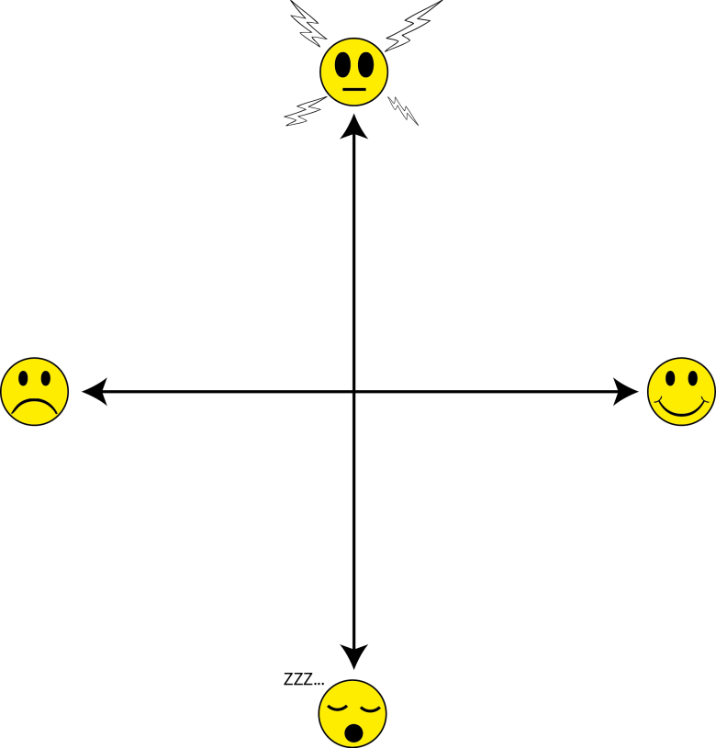
Insitu Experimentation
The “Palais des Beaux-Arts”, Lille France
Experimentation location
Protocol
Ok, but what is SYM ?

Slide 72
Insitu Experimentation
The “Palais des Beaux-Arts”, Lille France
Experimentation location
Protocol
Ok, but what is SYM ?
High valence happy

Slide 73
Insitu Experimentation
The “Palais des Beaux-Arts”, Lille France
Experimentation location
Protocol
Ok, but what is SYM ?
Low valence
sad
High valence happy

Slide 74
Insitu Experimentation
The “Palais des Beaux-Arts”, Lille France
Experimentation location
Protocol
Ok, but what is SYM ?
High arousal totally awaken
Low valence
sad
High valence happy

Slide 75
Insitu Experimentation
The “Palais des Beaux-Arts”, Lille France
Experimentation location
Protocol
Ok, but what is SYM ?
High arousal totally awaken
Low valence
sad
High valence happy
Low arousal
falling asleep

Slide 76
Insitu Experimentation
The “Palais des Beaux-Arts”, Lille France
Experimentation location
Protocol
Ok, but what is SYM ?

Slide 77

Insitu Experimentation
The “Palais des Beaux-Arts”, Lille France
Experimentation location
Protocol
Ok, but what is SYM ?

Slide 78
Insitu Experimentation
The “Palais des Beaux-Arts”, Lille France
Experimentation location
Protocol
Ok, but what is SYM ?
Mood A
Mood B
Mood C

Slide 79
Insitu Experimentation
The “Palais des Beaux-Arts”, Lille France
Experimentation location
Protocol
Ok, but what is SYM ?
Mood A
Mood B
Mood C

Slide 80
Insitu Experimentation
The “Palais des Beaux-Arts”, Lille France
Experimentation location
Protocol
Ok, but what is SYM ?
Mood B
Recorded and synchronized with location and time information

Slide 81
Insitu Experimentation
The “Palais des Beaux-Arts”, Lille France
Experimentation location
Protocol
Ok, but what is SYM ?
Kevintastic, isn’t it ?

Slide 82
M4Museum Museum Motion & Mood Mapping
Expected results & Sequels

Slide 83
Expected results & Sequels
Data gathered ?

Slide 84
Expected results & Sequels
Data gathered ?
Moodal information

Slide 85
Expected results & Sequels
Data gathered ?
Moodal information
Subjective POV video

Slide 86
Expected results & Sequels
Data gathered ?
Moodal information
Subjective POV video
Localization information

Slide 87
Expected results & Sequels
Data gathered ?
Moodal information
Subjective POV video
Localization information
Subjective resitu information

Slide 88
Expected results & Sequels
Data gathered ?

Slide 89
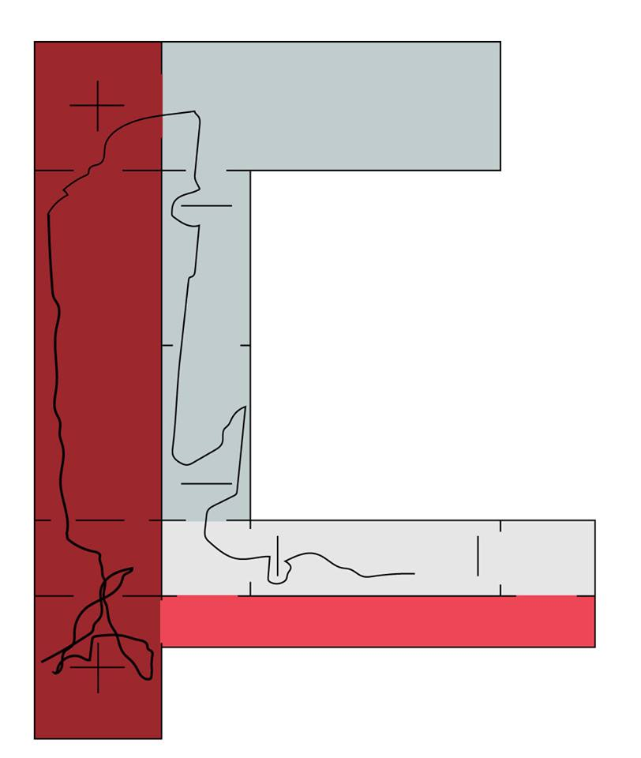
Expected results & Sequels
Data gathered ?
Satisfaction mapping

Slide 90
Expected results & Sequels
Data gathered ?
Satisfaction mapping

Slide 91
Expected results & Sequels
Data gathered ?
Satisfaction mapping
Sequels ?

Slide 92
Expected results & Sequels
Data gathered ?
Satisfaction mapping
Sequels ?
M4x : an operative and complete workflow for user experience spotting in ecological conditions

Slide 93
Expected results & Sequels
Data gathered ?
Satisfaction mapping
Sequels ?
M4x : an operative and complete workflow for user experience spotting in ecological conditions
Franco-Belgian patent

Slide 94
Expected results & Sequels
Data gathered ?
Satisfaction mapping
Sequels ?
M4x : an operative and complete workflow for user experience spotting in ecological conditions
Franco-Belgian patent
Billions of dollars (approx. )

Slide 95
That’s all folks
Thanks for all, we already miss you all

Slide 96
That’s all folks
Thanks for all, we already miss you all

