Slide 1
Enter the ROBiGAME Final presentation
F. Rocca, P.H. De Deken A. Bandrabur & M. Mancas
project8@enterface.net

Slide 2
Overview
Introduction
Handling the Reaplan
Kinect for user tracking
Serious Game linked to Reaplan
Conclusion and Future works

Slide 3
Introduction
The eNTERFACE project is related to the 3 years long WBHealth ROBiGAME project, funded by the Region wallonne, which officially began in October 2014.
The objective of this project is to develop an intelligent serious game for rehabilitation of the upper limbs for stroke patients using an interactive rehabilitation robot. The robot screenplay adapts to the patient's functional abilities and the robot mechanical assistance evolves according to patient’s motivational, motor and cognitive performances.

Slide 4
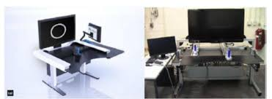
Handling the REAplan
ROBiGAME will be developed on the REAPlan robot providing a distal effector which can mobilize the patient upper limb(s) in a horizontal plane.
Motor deficiencies (strength, joint mobility, dexterity) will be evaluated clinically according to the validated protocols. An evaluation protocol of these deficiencies by the robot will be developed to provide quantitative and objective data. Force and position sensors will be used to assess:
Patient force;
Comprehensive passive and active range of motion by measuring the largest perimeter the subject can perform with or without assistance;
Kinematics and kinetics of the arm in standardized movements.
Illustration of the robotic system REAPlan1 and REAPlan 2

Slide 5
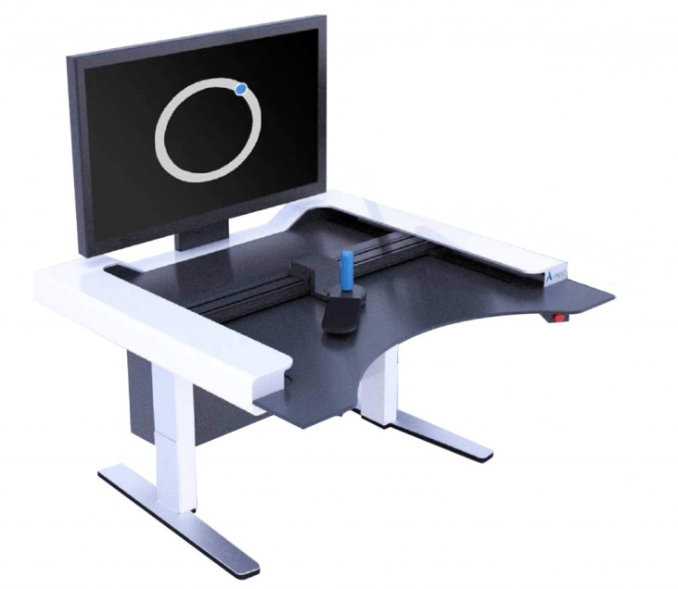
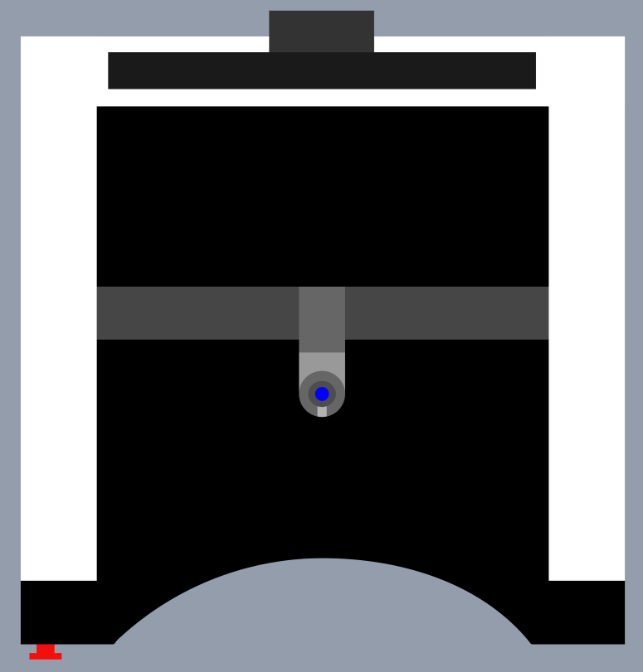
Handling the REAplan
REAplan description
TV( + support)
Working plan
Robotic arm (2 axes) with joystick
Emergency stop button

Slide 6
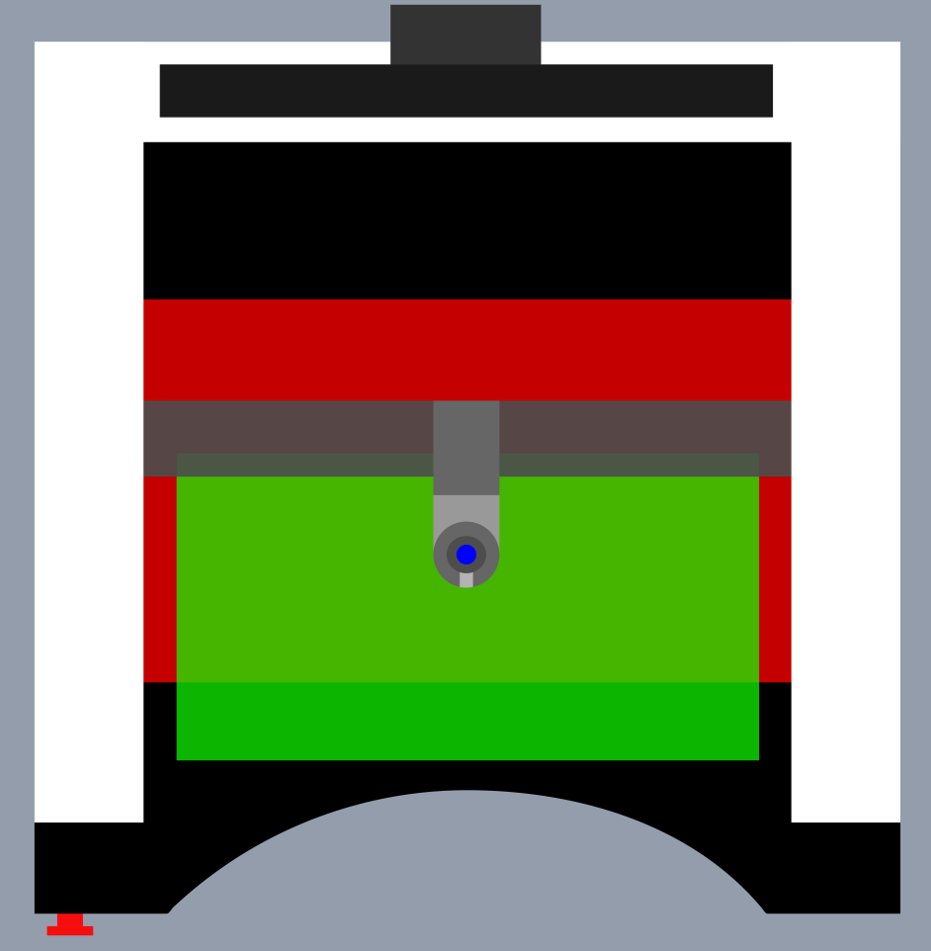
Handling the REAplan
Calibration is done on the whole table by moving the robotic arm
The red area is dedicated to the robotic arm movements during the therapy
The green area is thus the areas where the joystick is able to move

Slide 7
Handling the REAplan
Link REAPlan and pc : USB 2.0 (simulation COM port)
Usually:
Game -> Interface -> Robot
Here :
Game -> Robot
Need to recompile the Dll in .net 3.5 for unity
Unity3D | REAPlan
Dll in .net 3.5 max | Dll in .net 4.0

Slide 8
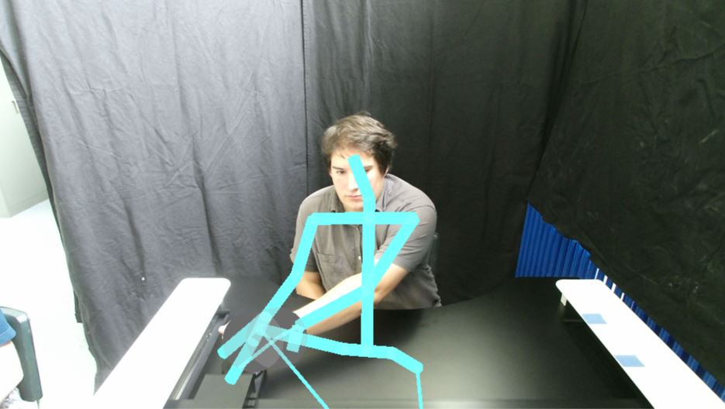
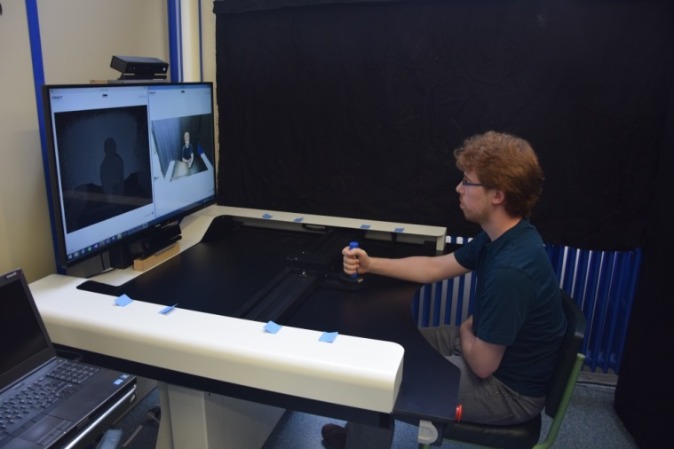
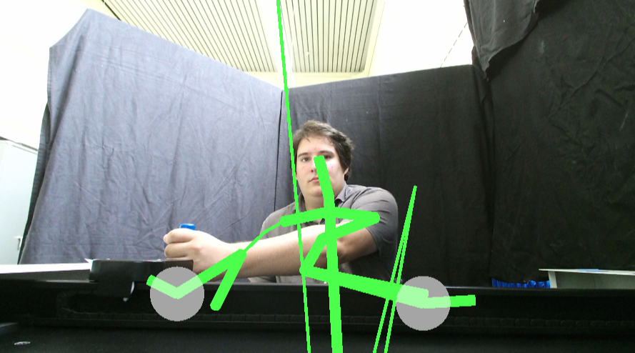
Kinect for user tracking
Two possible ways to put the Kinect
Instant body detection
Robust tracking (body and arm)
Body detected 6 second later
Not stable tracking
Notes:
The best position for the body and face tracking with the Kinect is placed on the top of the screen

Slide 9
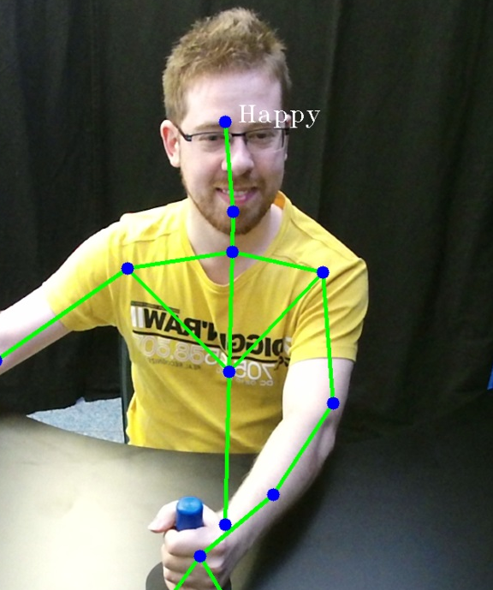
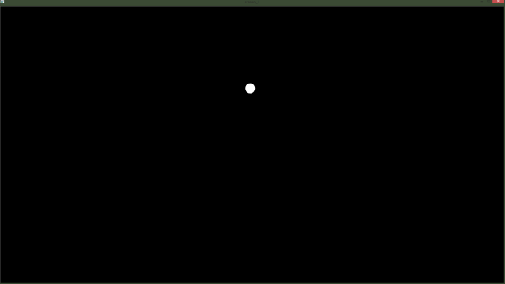
Kinect for user tracking
User tracking is done only on a small area in front of the REAPlan -> only to track the patient
In this area we track:
Upper body
Face expressions
Head pose estimation
These data are sent to the game by OSC
Happy face
Where the user look on the screen

Slide 10
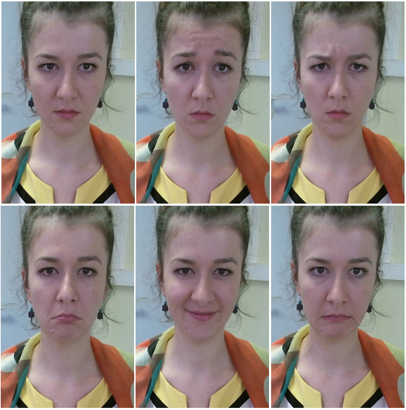
Kinect for user tracking
Face expression will be improve using FACS
The FACS theory states that face muscles can produce a number of 46 basic facial actions named action units (AU)
We will track specific facial
movements as the ones
alongside to detect the frustration Vs the engagement
Neutral face, AU1 inner brow raiser, AU 4 brow lowerer, AU15 lip corner depressor, AU12 lip corner puller, AU20 lip stretcher

Slide 11
Kinect for user tracking
Kinect SDK offers the information of 17 AU
Motivation (index used to change the gameplay)
Confusion and frustration are described by a high value of AU1 (inner brow raiser)
Anger, agitation and insecurity are described by a high value of AU4 (brow lowerer)
Sadness is described by the following combination
low value of AU20 (lip stretcher), high value of AU15 (lip corner depressor) and low value of AU12 (lip corner puller)
low value of AU20 (lip stretcher), high value of AU15 (lip corner depressor) and normal value of AU12 (lip corner puller)
All these expressions can be discriminate with their opposite to build the motivation index
Notes:
The best position for the body and face tracking with the Kinect is placed on the top of the screen

Slide 12
Kinect for user tracking
We have try to use the Wekinator
Wekinator is a framework for real-time machine-learning, which allows you to train and modify machine-learning algorithms in real-time
The inputs may consists in audio, video or gesture data which are used to train the learning algorithm responding to this specific inputs
The results are encouraging, but we have not had time to use them to modify the gameplay
Input FACE using Kinect sensor
High definition face tracking (c++)
Extracting the Animation Units and providing them to The Wekinator
Creating training examples
Classification by regression
Notes:
The best position for the body and face tracking with the Kinect is placed on the top of the screen

Slide 13
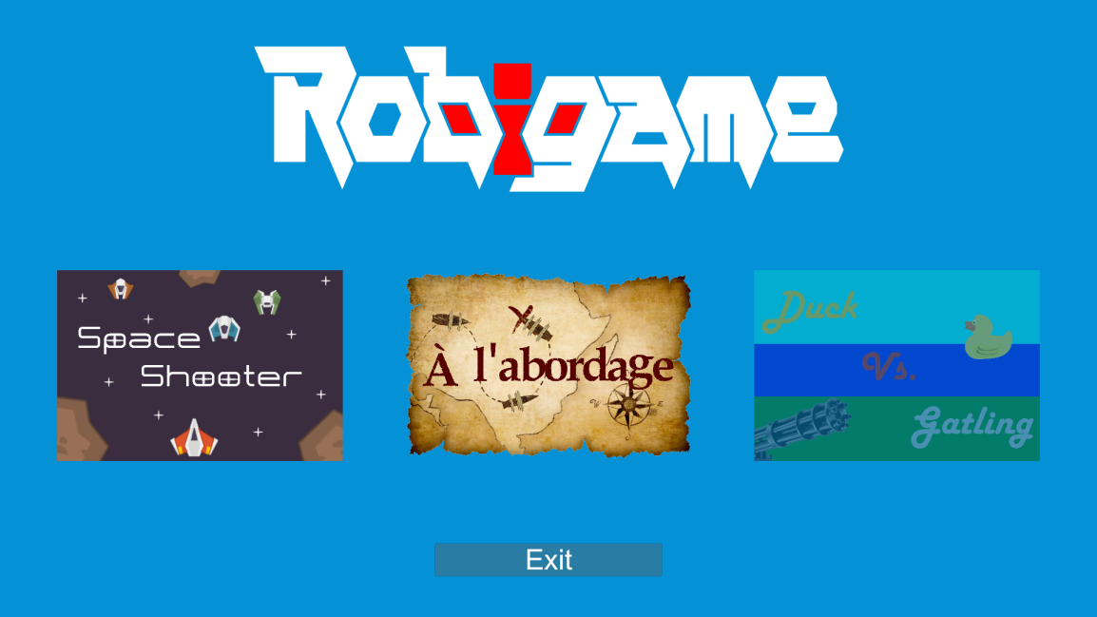
Serious Games
3 games were developed
Unity3D project
2D plan Game

Slide 14
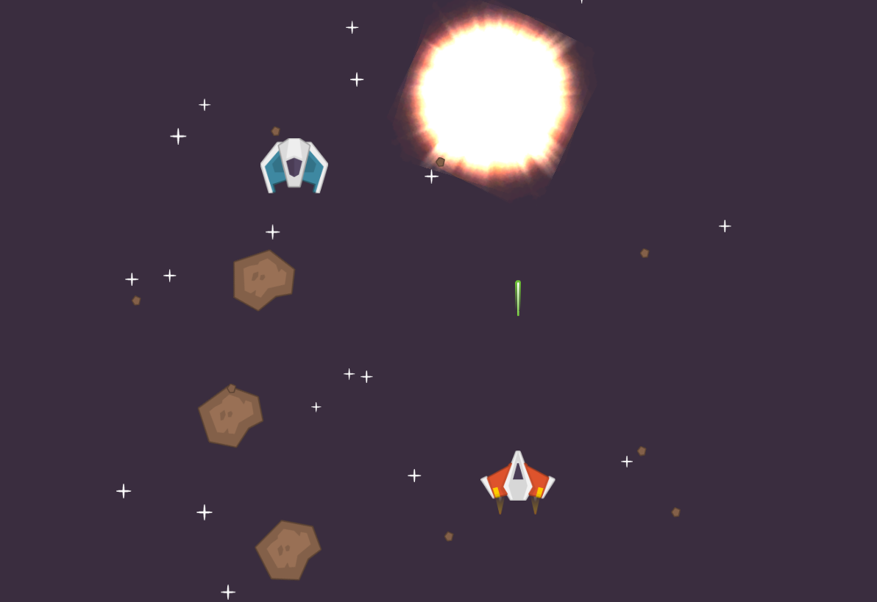
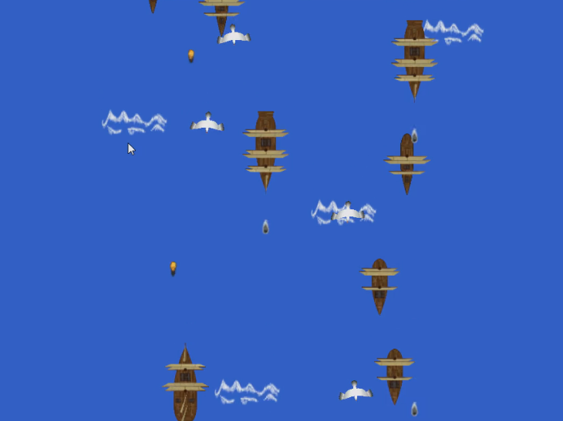
Serious Games
Game:
Space shooter À l’abordage
The Duck Game is not yet finished

Slide 15
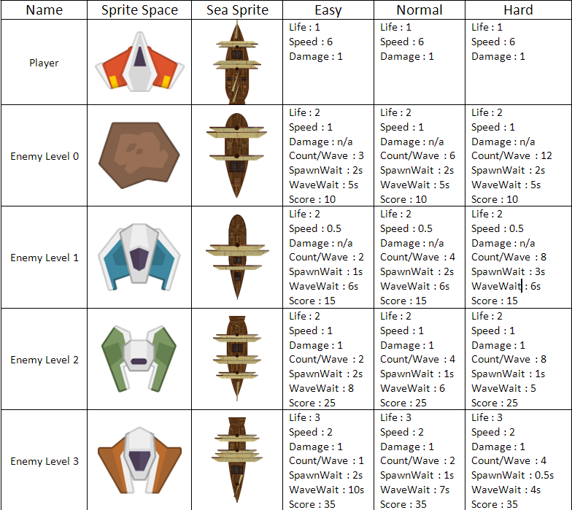
Serious Games
Sprite an game data

Slide 16
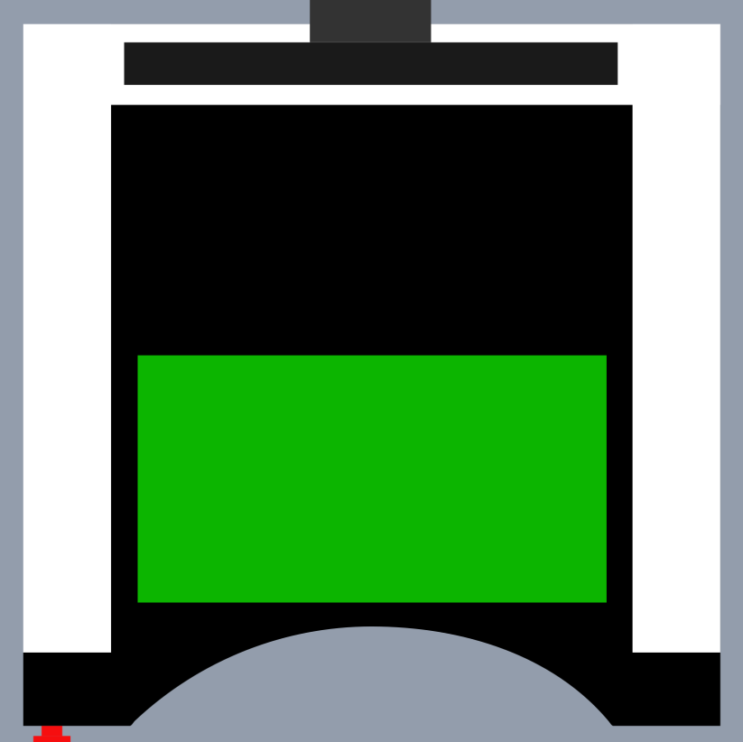

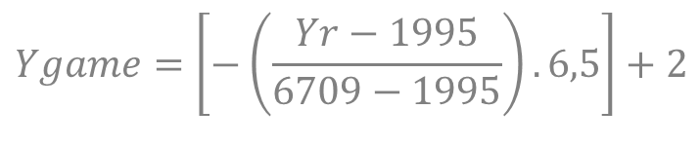
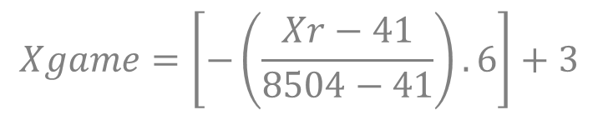
Serious games
Mapping: Therapy plan ⬄ Game plan
(-3;2)
(3;-4,5)
Xr
Yr
(8504 ; 1995)
(41; 1995)
Yg
Xg
(-3;-4,5)
(3;-4,5)
(8504; 6709)
(41; 6709)
$$Xgame=\left[−\left(\frac{Xr−41}{8504−41}\right).6\right]+3$$
$$Ygame=\left[−\left(\frac{Yr−1995}{6709−1995}\right).6,5\right]+2$$

Slide 17
Diagram of the games
MenuScene
Each game scene use the sames scripts
One boolean changes specificities
SpaceScene
SeaScene
DuckScene
Only one scene can be at the screen at one time.
If we load another, it delete in totality the previous scene unless we specify exceptions.
WARNING:
Notes:
A scene is usualy a level of a game. It can also be a menu for example.
The 3 games have more or less the same gameplay so we used the same script. We just modify some part of the code according to a variable that specify which game we are currently playing.

Slide 18
Diagram of the games
The script about Port Com create a GameObject
The script about OSC create a GameObject
The script about config create a GameObject
GameObject PortController
GameObject
OSCController
GameObject
ConfigController
Protecting GameObject from suppression when loading another scene
Protecting GameObject from suppression when loading another scene
Protecting GameObject from suppression when loading another scene
Port creation, initialization and opening
Osc server creation and initialization
Creating configuration variables
Sending command to REAPlan to calibrate and enter into free mode
Message Received?
NO
YES
Acquiring position of distal effector
Update difficulty variable
Update X and Y position variables
Notes:
A GameObject is the name of an object in Unity 3D.
A script is usualy a class that contains all the methods and variables that are linked to a particular GameObject.
At the first call of each script, it will create and attach himself to a GameObject as we can see in the slide.
The variables specified in this slide are all accessible from anywhere in the application (game).

Slide 19
Diagram of the games
Start
Launching ennemies
Moving player according the X and Y position variables
Modifying the number of enemy according the difficulty variables
Creating shot from player and enemies and checking if a shot touch something
Is game over?
NO
YES
Restart?
YES
NO
Is key ESC pressed?
Going back to the menu
End
YES
NO
Notes:
Any game follow this logic.
At every moment (update) the game check if the user pressed ESC.

Slide 20
Conclusion
REAplan controls the Serious games
Kinect tracks the upper body and the face
User information are used to change gameplay in real-time

Slide 21
Future works
Complete the 3rd game
Body and arm tracking with Kinect and Qualisys for comparison (according therapist)
Body points and face features exploitation:
Include Action unit analysis
Measuring the displacement of the arm
Game stabilization and therapy rules discussion

Slide 22
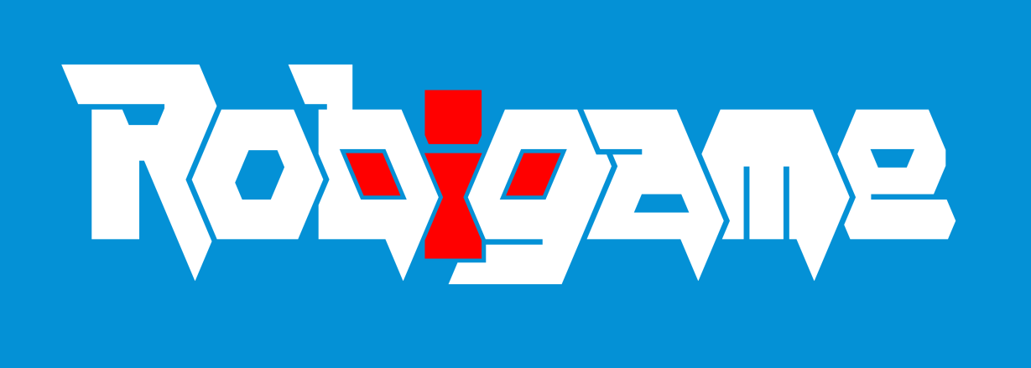
Thank you for your attention

